Slide 1
DO YOU GET
PANIC NOW?
Burhan Rafid Ekatama
Student of Data Science Bootcamp 19

Slide 2
Table of contents
01
02
03
04
PROBLEM OVERVIEW
DATA UNDERSTANDING
MODELLING AND RECOMMENDATION
QUESTION AND SOCIETY INSIGHT

Slide 3
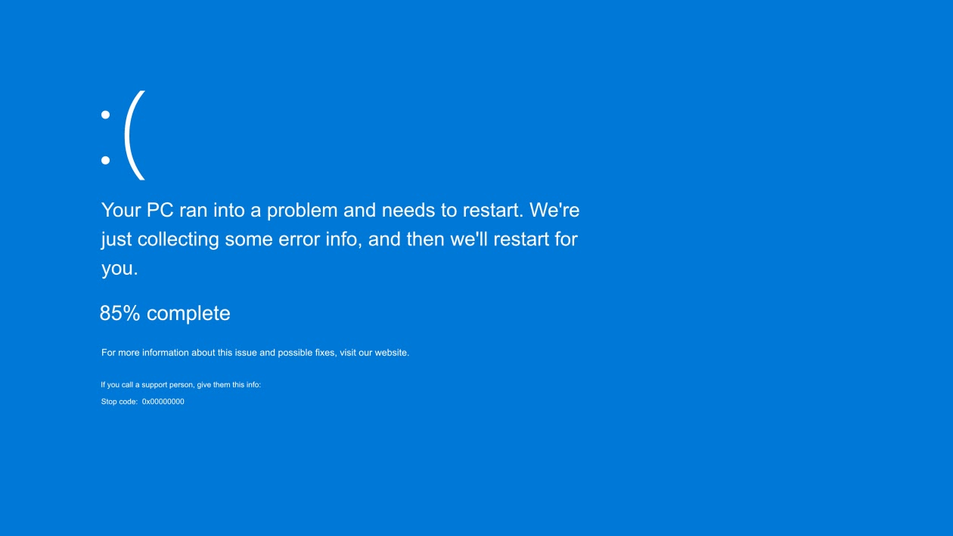
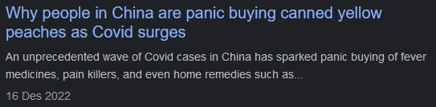

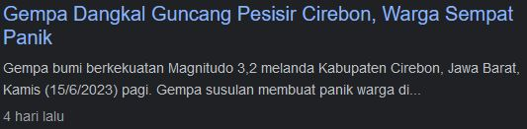
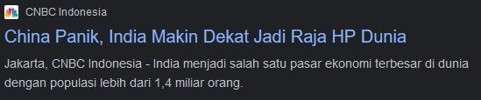
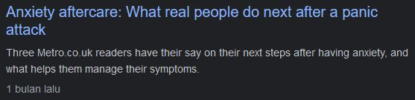
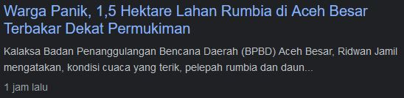
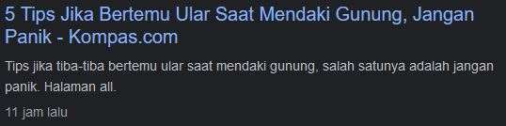
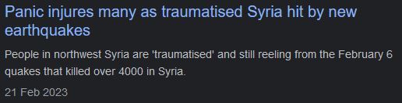
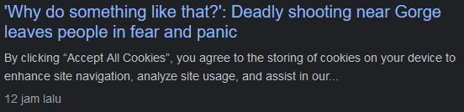
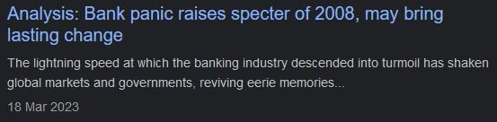
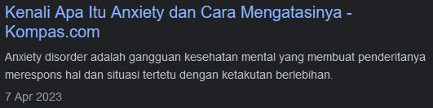

Slide 4

Panic attacks are feelings of intense fear and anxiety. Panic attacks often occur when a person is worried about something in their life or has experienced something very difficult and stressful (www.unicef.org)

Slide 5
Anxiety is a feeling of discomfort, such as worry or fear, that can be mild or severe. For example, feeling worried and anxious when facing exams, when going to undergo medical tests or job interviews (www.nhs.uk)

Slide 6
PROBLEM OVERVIEW
The processed data consisted of 120,000 respondents
Goals:
  Predict the best model for patients who are suspected of having panic disorder or not
  Providing insight to the wider community about panic disorder

Slide 7
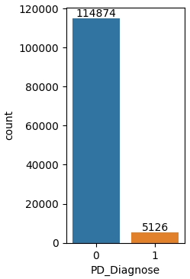
PROBLEM OVERVIEW
Positive vs Negative Panic Disorder
Out of 120,000 respondents, there were 5126 respondents (4.27%) who positively Panic Disorder

Slide 8
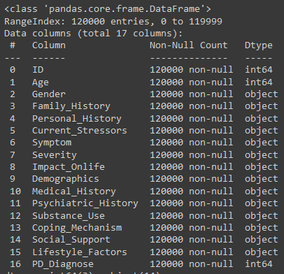
DATA UNDERSTANDING

Slide 9
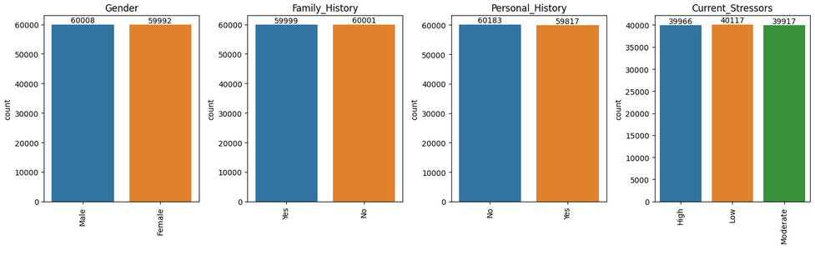
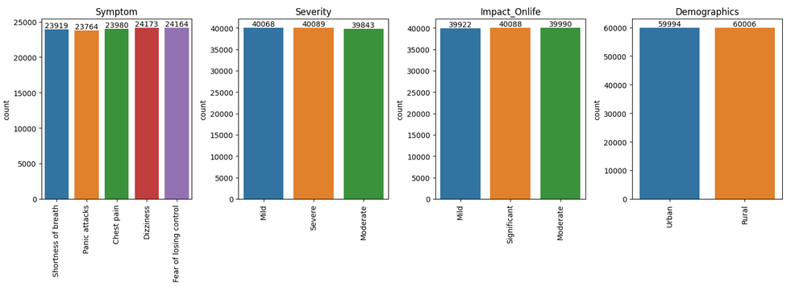
DATA INSIGHT

Slide 10
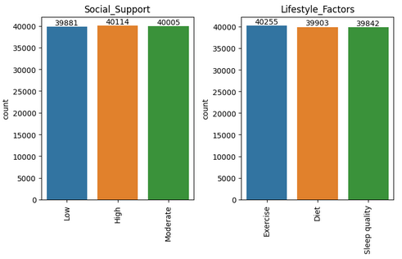
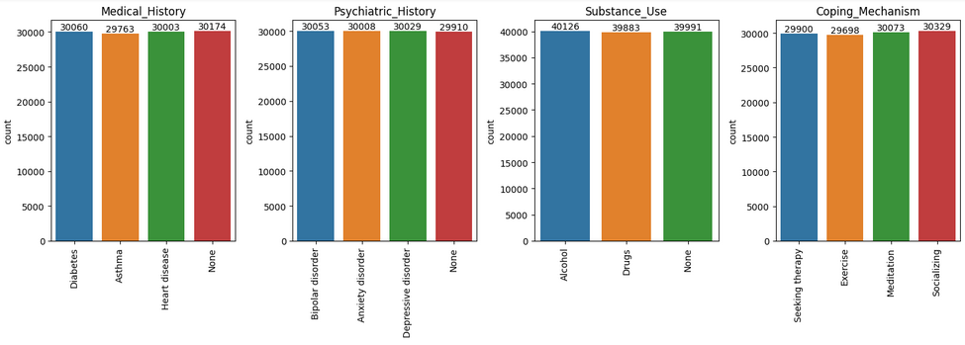
DATA INSIGHT

Slide 11
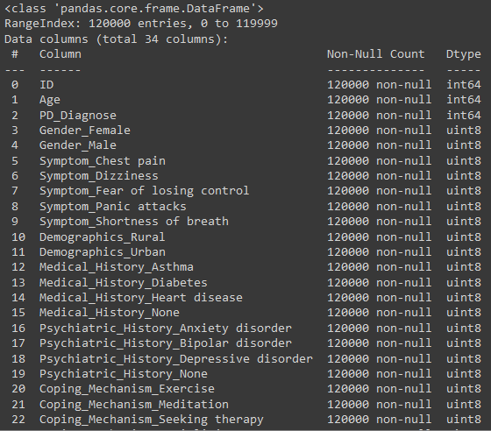
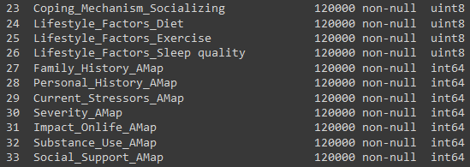
MODELLING AND RECOMENDATION
Data Engineering

Slide 12
MODELLING AND RECOMENDATION
Data Engineering
Data Engineering
  One Hot Encoding (‘Gender’ , ’Symptom’ , ‘Demographics’ , ‘Medical_History’ , ‘Psychiatric_History’ , ‘Coping_Mechanism’ , ‘Lifestyle_Factors’)
  Label Encoding (‘Family_History’ , ‘Personal_History’ , ‘Current_Stressors’ , ‘Severity’ , ‘Impact_Onlife’ , ‘Substance_Use’ , ‘Social_Support’)

Slide 13
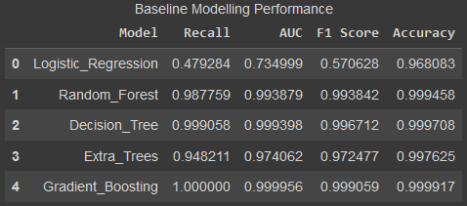
MODELLING AND RECOMENDATION
Data Engineering
Baseline Modelling
Accuracy Level for Baseline Models tend to be high (> 0.95 or above 95%). But because the data used is Imbalance Data, it is necessary to do Undersampling

Slide 14
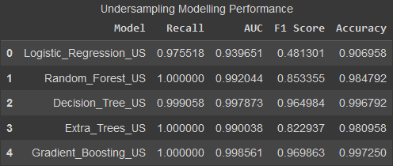
Modelling and Recommendation
Undersampling Modelling
Using Undersampling because the data obtained is sufficient and no data synthesis is needed.
Based on the table beside, it can be concluded that the best model is the Gradient Boosting Classifier.
The highest Accuracy value (0.997)
The highest f1 score (0.969863)
High Recall Rate (1,000)

Slide 15
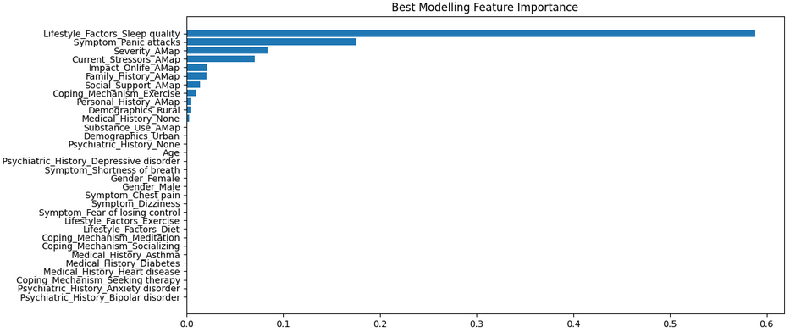
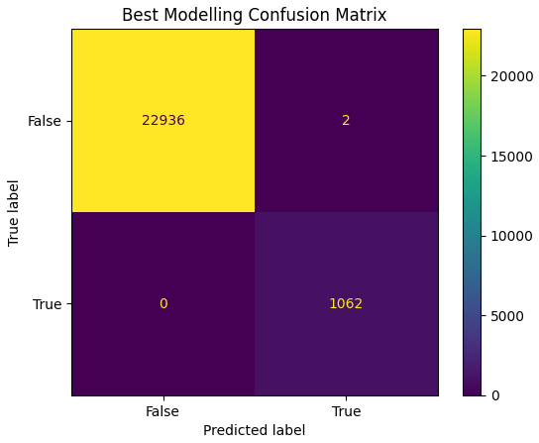
Modelling and Recommendation
The recall value is 1,000, meaning that out of 100 people who are predicted not to have panic disorder, all of them do not experience this disorder
Based on the most influential variables in panic disorder are Lifestyle, Symptom, Severity, Current Stressor, Impact On Life of the respondent's life, Family History, Social Support, and Coping Mechanisms

Slide 16
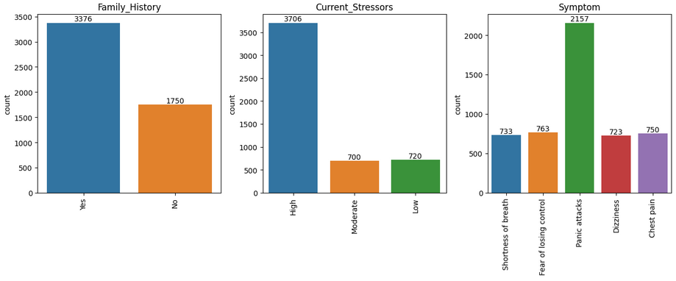
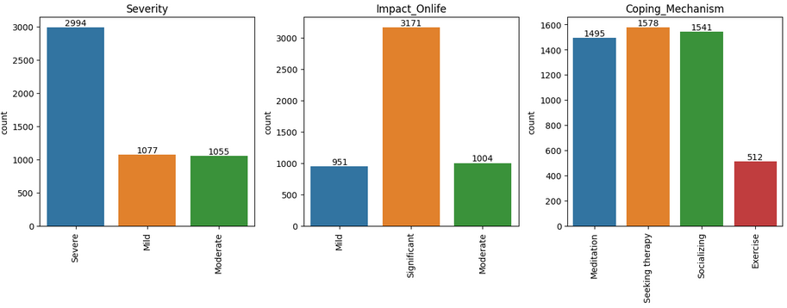
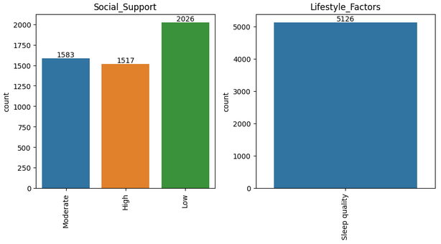
Question 1
Based on all positive Panic Disorder patients, the highest factor of the most influential variables is:
Yes from the Family History (65.86%)
High from Current Stressors (72.3%)
Panic Attacks from Symptom (42.08%)
Severe from Severity (58.41%)
Significant fromthe Impact On Life (61.86%)
Seeking Therapy from the Coping Mechanism (30.78%)
Low from the Social Support (39.52%)
Sleep Quality from Lifestyle Factors (100%)

Slide 17
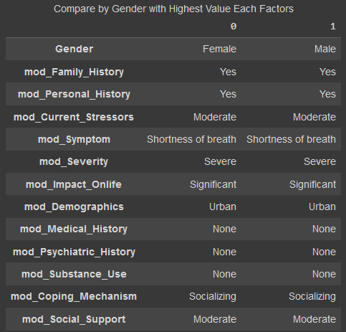
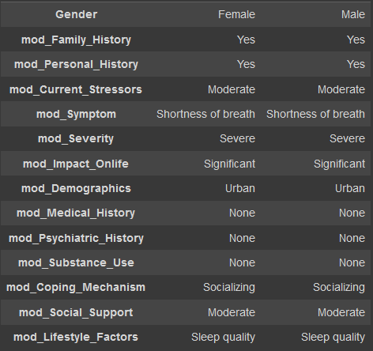
Question 2
Try to compare between men and women who experience panic disorder
It turns out that both men and women who experience panic disorder overall have the same background

Slide 18
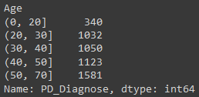
Question 3
Try to separate them from positive panic disorder respondents, divided by age
There was a significant increase in patients between the ages of 0-20 and the ages of 20-30 (692 patients)
It turns out that the older a respondent is, the more susceptible he is to panic disorder

Slide 19
Society Insight
Panic attack is a sudden onset of intense fear and triggers a severe physical reaction when perceived danger. When a panic attack occurs, it can result in losing control, or even having a heart attack.
If a person experiences repeated and unexpected panic attacks, and spends a long time in constant fear, that person may have a condition called panic disorder.
www.mayoclinic.org

Slide 20
Society Insight
For some people, panic disorder can lead to agoraphobia (phobia of crowded environments).
There is no sure way to prevent Panic Attacks or Panic Disorder. However, some things to relieve can be done by:
Get treatment as soon as possible to help stop it getting worse or becoming more frequent.
Consult an expert for treatment to prevent recurrence or worsening of symptoms.
Get regular physical and social activity, which can play a role in reducing the symptoms of panic attacks.
www.mayoclinic.org

Slide 21
Society Insight
Based on the best model chosen, it is hoped that it can more quickly detect a person or patient who is suspected of having Panic Disorder. Because the faster the first treatment of a patient can increase the percentage of recovery from that patient.
From the several main factors that cause Panic Disorder that have been mentioned previously, it can be a reference for public to pay more attention to other people around them who are felt to have positive signs to be able to help immediately.
www.mayoclinic.org

Slide 22
REFERENCES
https://www.unicef.org/indonesia/id/kesehatan-mental/artikel/serangan-panik
https://www.nhs.uk/mental-health/conditions/generalised-anxiety-disorder/overview/
https://www.mayoclinic.org/diseases-conditions/panic-attacks/symptoms-causes/syc-20376021

Slide 23


:)
Thankyou.
Reach me out anytime:
LINK PROJECT

